Slide 1
PAWSITIVE MATCH: A Pet Adoption Management System
Name: Amal Nourin M
Department: B.Tech, Computer Science & Engineering
Date: 19-11-2025
Subject: Database Management System (DBMS)
Program Name: B.Tech CS Regular

Slide 2
INTRODUCTION
Overview “Pawsitive Match" is a full-stack, 3-tier web application designed to modernize the pet adoption. It functions as a dynamic portal that securely connects two distinct types of users—Customers (Adopters) and Admins (Shelters)—to a central MySQL database.
Motivation Traditional adoption processes are often slow, decentralized, and rely on paperwork. Shelters lack an efficient, integrated tool to manage their inventory of pets and the applications for them simultaneously.
Objectives To design and implement a relational database (MySQL) to store all application data. To build a secure, role-based system with separate login portals and dashboards for Users and Admins. To create a Node.js/Express API to securely manage all data transactions (CRUD operations). To allow users to view dynamic pet listings and submit personalized adoption requests. To empower shelter admins to add new pets and manage the entire lifecycle of an adoption request (Approve/Reject).

Slide 3
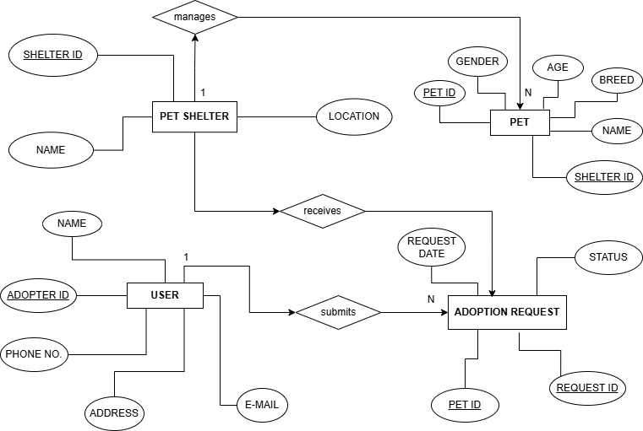
ER DIAGRAM

Slide 4
FRONTEND & BACKEND
FRONTEND HTML5: Used for the application's structure and content. CSS3: Used for all custom styling, layout, and branding (first-page.css). Bootstrap 4: A responsive framework used for the layout of forms, cards, and navigation. JavaScript (ES6+): The "brain" of the frontend. Used for:
BACKEND Node.js: The JavaScript runtime environment that executes our server code. Express.js: The API framework used to build our routes (e.g., /api/login, /api/pets). MySQL: Our relational database, managed in MySQL Workbench. mysql2: The Node.js driver that allows our Express server to connect and run queries on the MySQL database. cors: Critical middleware to allow our frontend (on port 5501) to securely talk to our backend (on port 3000).
DOM Manipulation: Dynamically rendering pet cards and request lists.
fetch API: Making asynchronous requests (GET, POST, PUT) to our backend API.
localStorage: Storing session data (userId, userName, userRole) to keep users logged in and display the correct navbar.

Slide 5
METHADOLOGY
Module 2 : Dynamic Navigation (nav-loader.js) Goal: Create a user-specific navigation bar. Logic: Script runs on page load and checks localStorage for userRole. Result (Logged In): Hides "Login/Register" links. Result (Logged In): Shows "My Dashboard" & "Logout" links. Result (Logged In): "Home" link redirects to the user's correct dashboard.
Module 1 : Dual Authentication Goal: Secure, separate logins for Users and Admins. API: POST /api/login (checks users table). API: POST /api/admin-login (checks admins table). Result: Returns userRole to localStorage to manage the session.
Module 3 : Shelter Management (Admin CRUD) Goal: Give shelters full control over inventory and applications. Read: GET /api/shelter/requests → Fetches all 'Pending' requests. Update: PUT /api/shelter/requests/:id → Approves or Rejects a request. Create: POST /api/shelter/pets → Adds a new pet to the database.
Module 4 : User Dashboard (Customer Workflow) Goal: Show a personalized history to each customer. API: GET /api/requests/user/:userId Logic: Fetches only the adoption history matching the logged-in user's ID. Result: User can track the status (Pending, Approved, Rejected) of their applications.

Slide 6
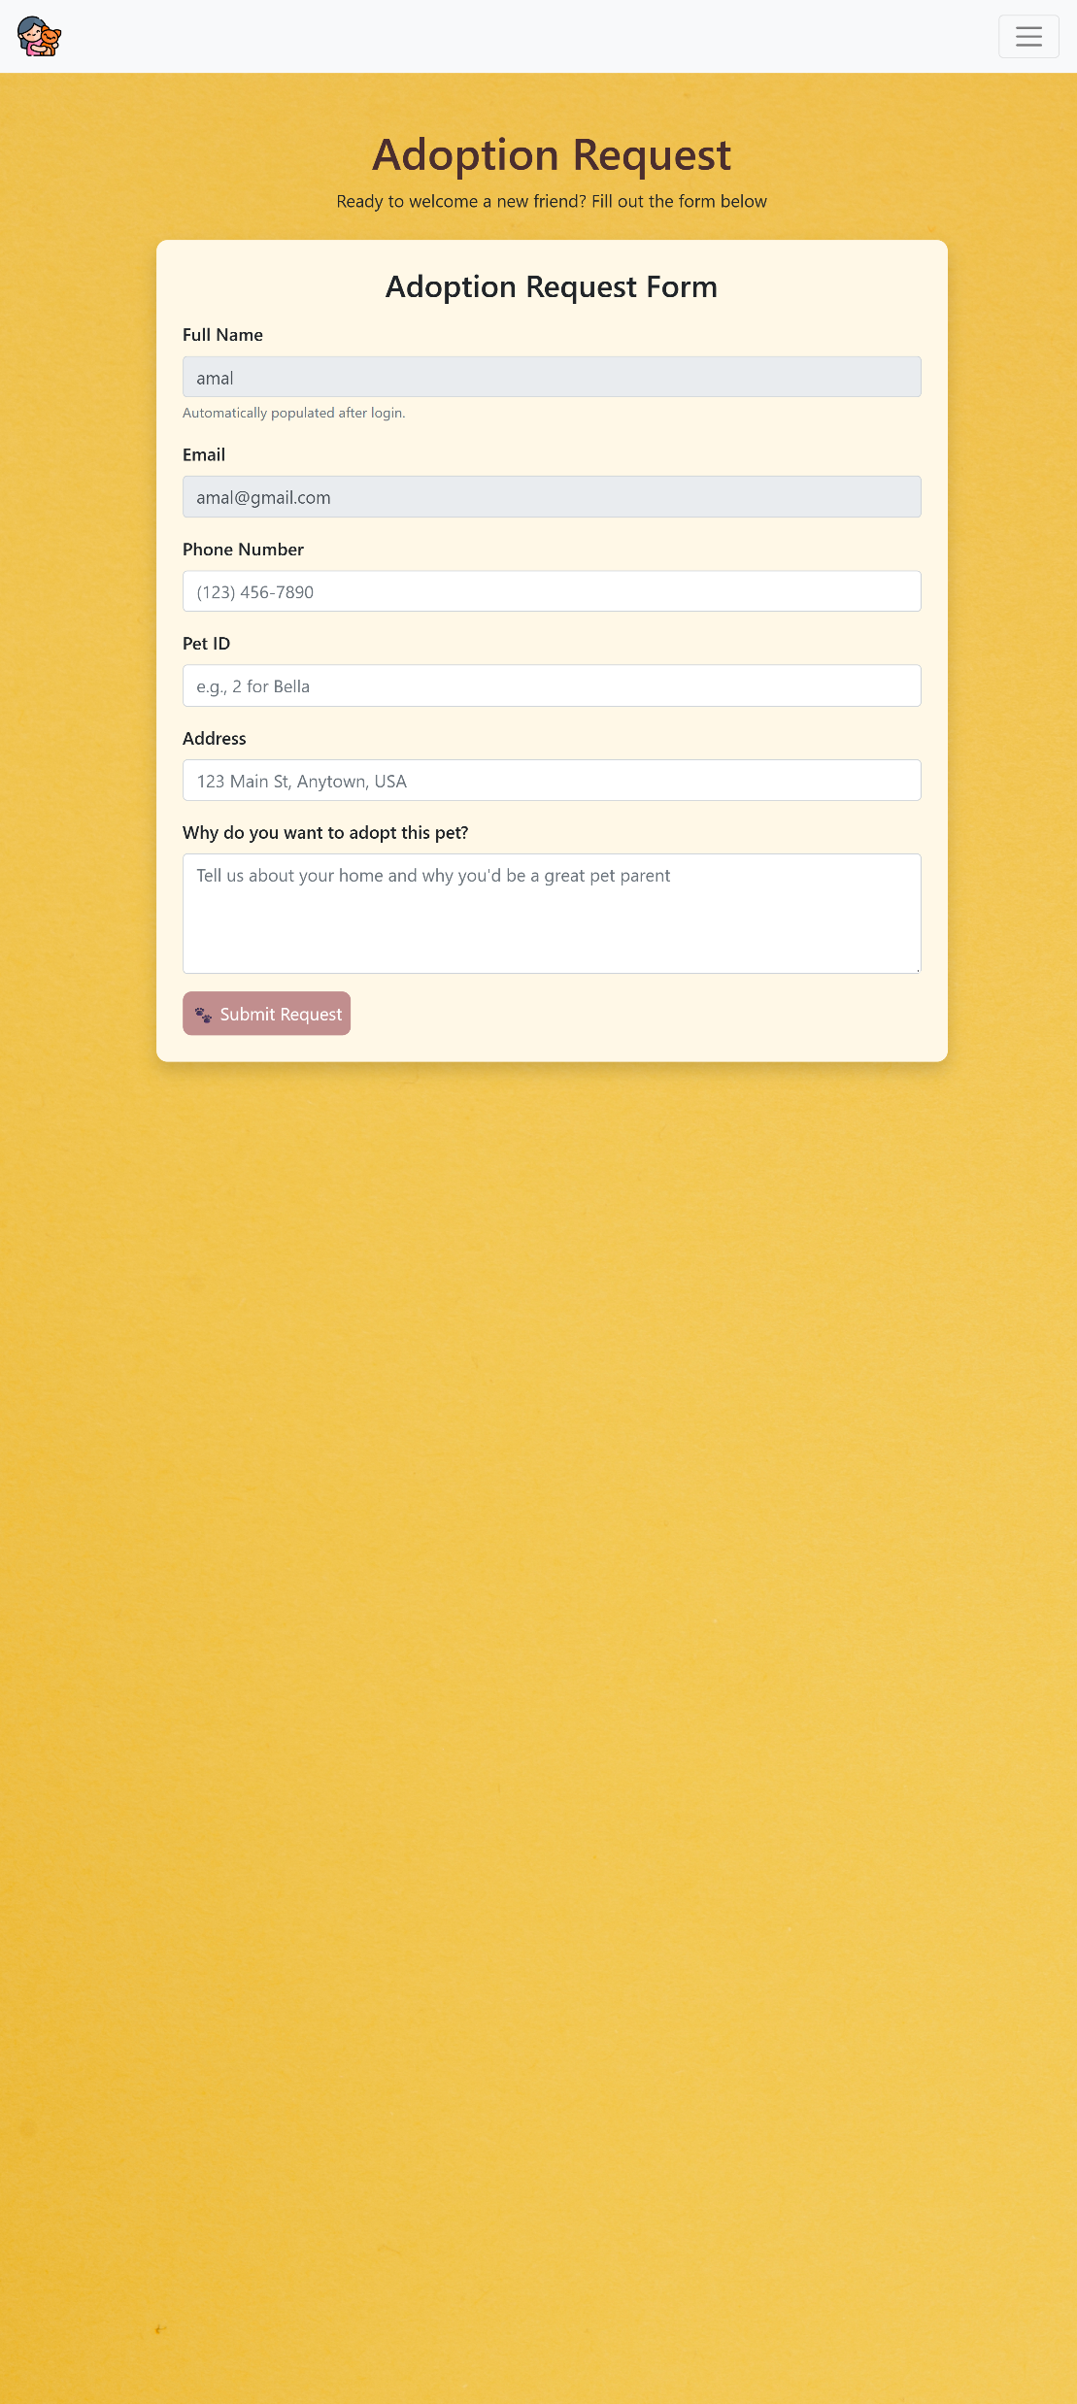
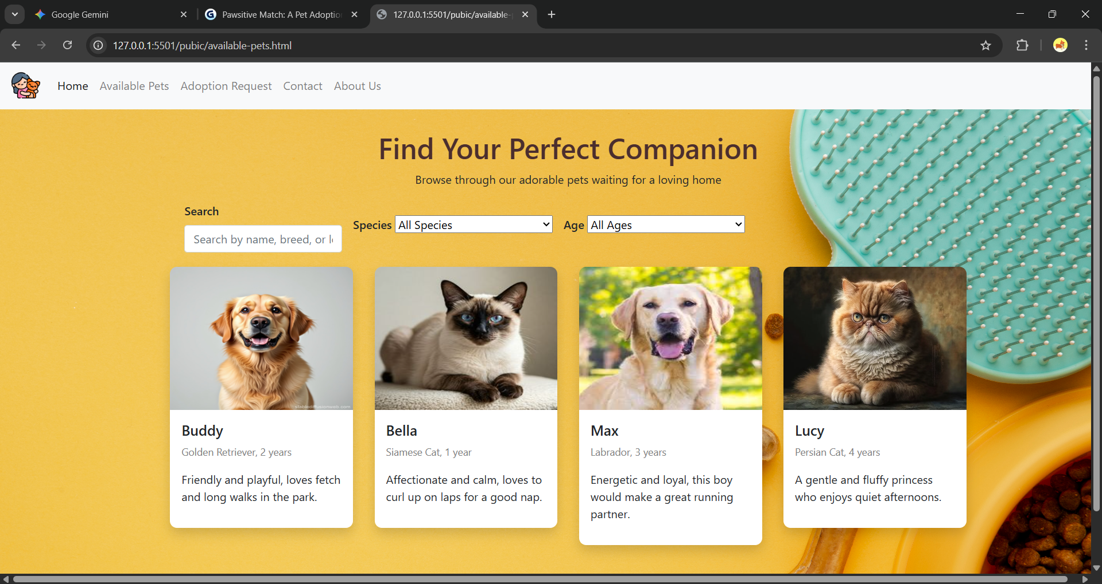
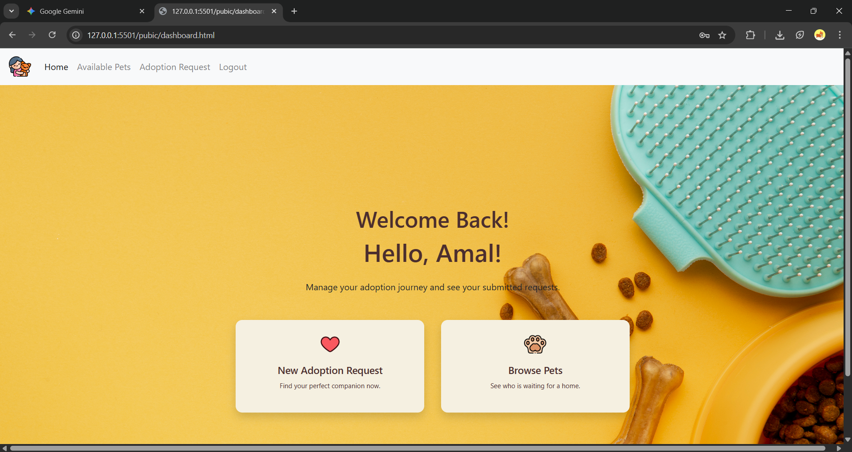
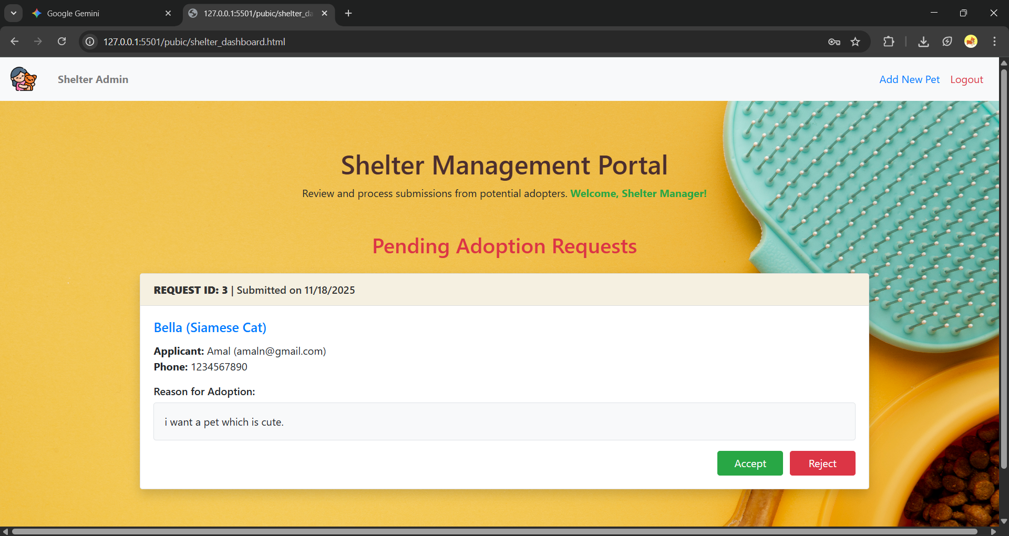
IMPLEMENTATION

Slide 7
CONCLUSION
Conclusion Pawsitive Match successfully demonstrates the design and implementation of a 3-tier, full-stack application. It proves the effectiveness of using a Node.js/Express API as a secure middleman between a public-facing website and a relational MySQL database. The project successfully implements secure, role-based authentication and a complete CRUD (Create, Read, Update) workflow for managing all aspects of the adoption process.
Future Scope (What I would do next) Password Hashing: Implement the bcrypt library in server.js to hash all user and admin passwords before saving them to the database, which is essential for real-world security. Full File Uploads: Integrate a cloud storage service (like AWS S3 or Firebase Storage) for the "Add Pet" form, so the admin can upload an actual image file instead of just typing the filename. Email Notifications: Use a Node.js library like Nodemailer to automatically send an email to a user when their adoption request status is updated to "Approved" or "Rejected."

